Slide 1
Pill Dispensing Medicine Assistant
Mini Project/Electronic Design Workshop (ECP358), SEM: VI
Ishita Jaiswal(31) Labdhie Bendey(34) Ganesh Moroliya(102) Hemant Paunikar(103)
Prof. Vipul S. Lande
Session 2023-24
Department of Electronics & Communication Engineering

Slide 2
Problem Statement and Objectives
Problem Statement:
Creating an automatic dosage based pill dispenser to improve medication adherence and
reduce dependance on caregivers.
Project Objectives:
Creating a domestic multi-medicine pill dispenser.
Enabling multiple slots for different medicines.
Develop a user-friendly interface to allow users to easily set alarm schedules.

Slide 3
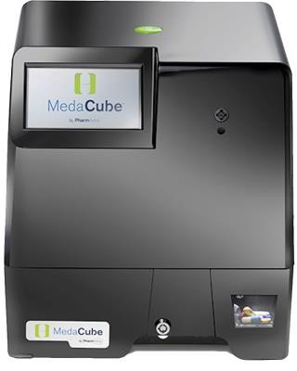
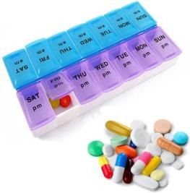
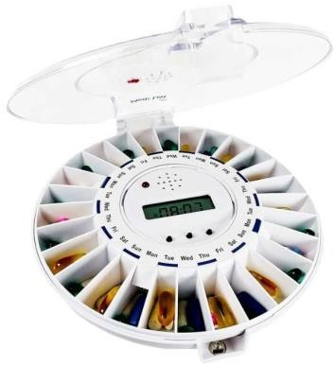
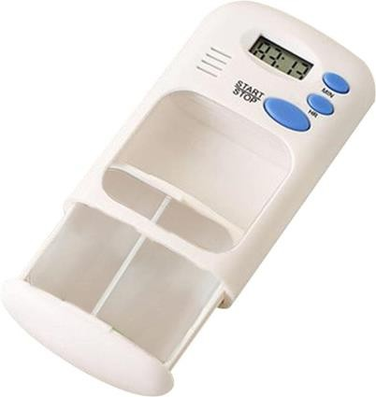
Existing Solutions and Literature Survey
PROBLEMS WITH THE PRODUCTS
1.Slot wise feeding which | 2. High upfront cost and | 3. Lack of diversity/range in medication
is user intensive | annual subscription fee | time and medicines available
USD 1199+100 annual subscription fee

Slide 4
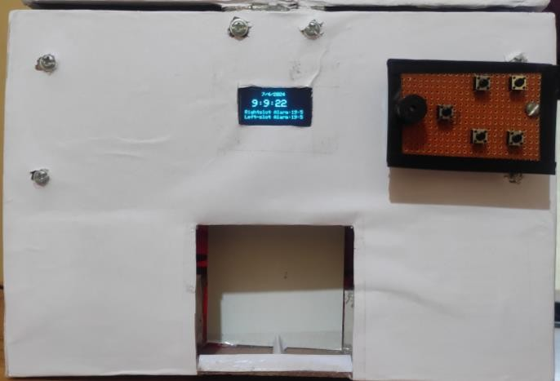
Features
1.Alarm-based pill dispenser: The dispenser
reminds you when it's time to take your pills.
2. Dispenses multiple medicines: It can give
you different pills at the same time.
3.Audible reminders: It makes a sound to let you know it's time to take your pills.
4.Usable by anyone: This means that anyone, regardless of age or ability, can use the pill dispenser easily.
5.Once set, the alarm activates daily as set until alarm time is changed.

Slide 5
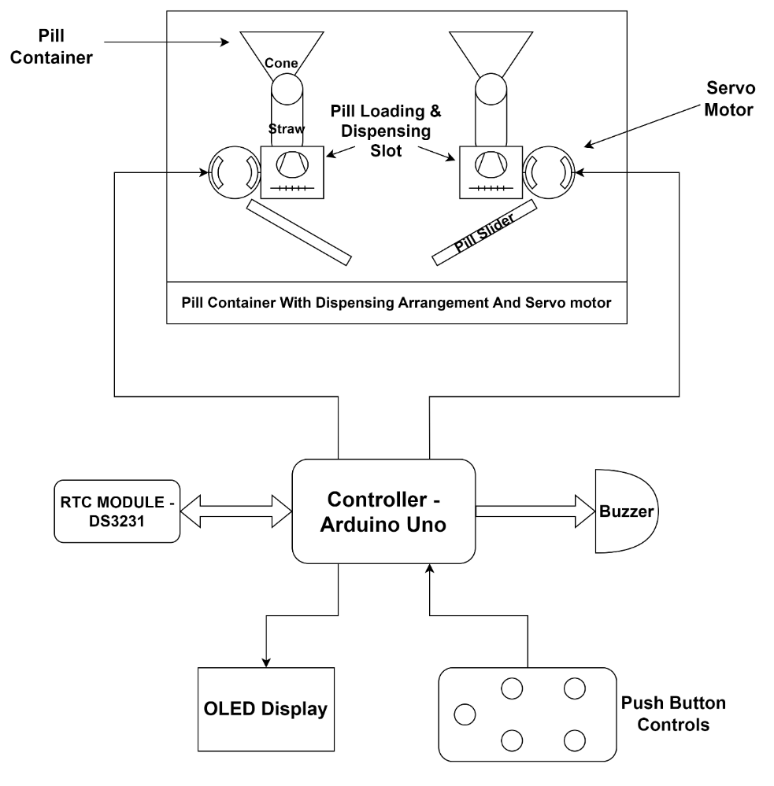
Block Diagram

Slide 6
Description of Block Diagram
The Arduino Uno is utilized to interface with all the components.
The RTC module is responsible for keeping track of time and supplying data for displaying the time.
The OLED serves as the output device, displaying both the current time and the
selected alarm time.
Push buttons are incorporated to allow users to input the desired time for setting the alarm.
A servo motor is employed to load the pill and dispense it at the designated alarm
time.
The buzzer emits a sound at the designated alarm time as indicated by the Arduino output

Slide 7
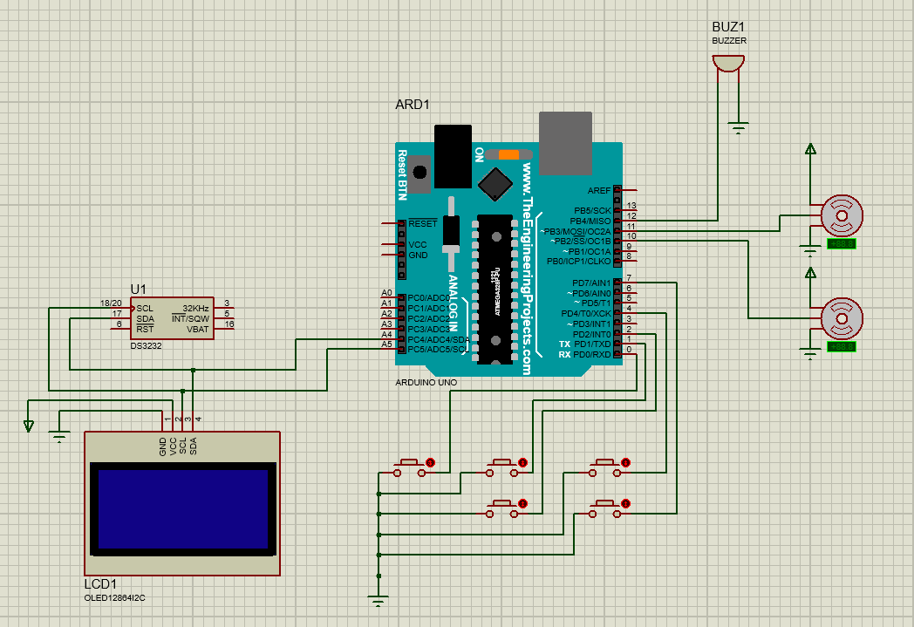
Circuit Diagram
ARDUINO UNO
BUZZER
RTC Module
Servo Motors
Switches
OLED Display

Slide 8
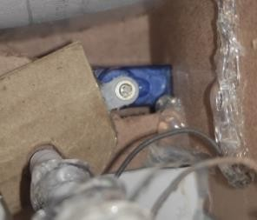
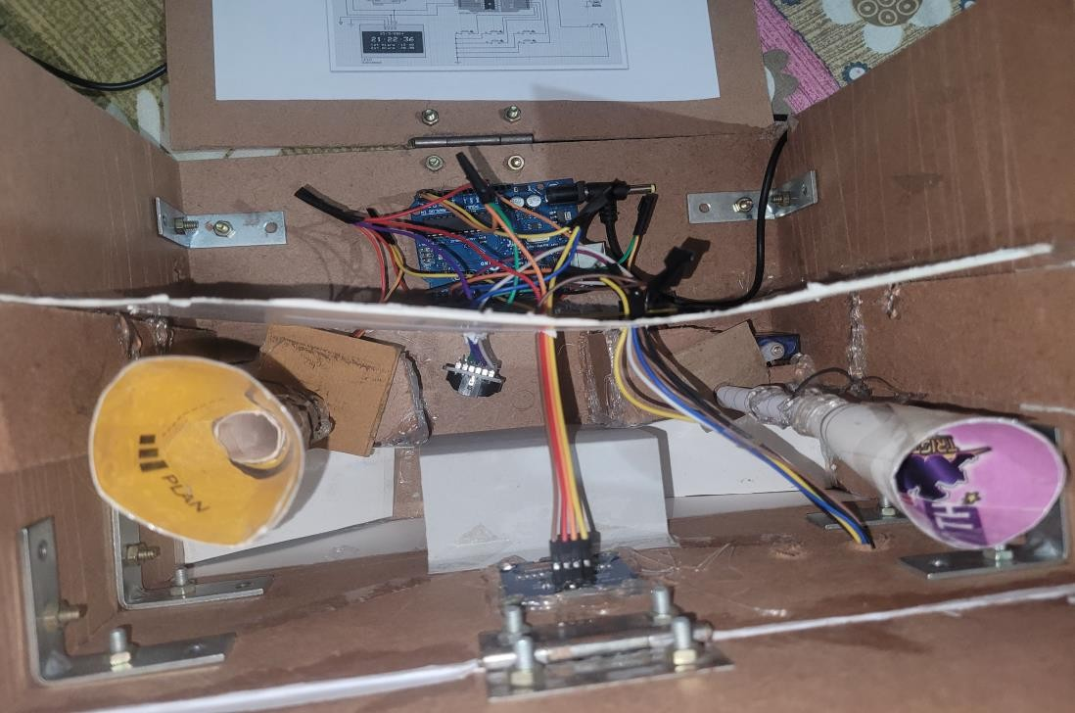
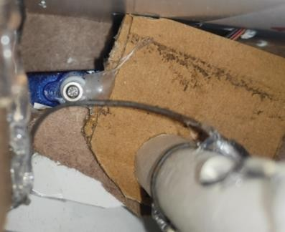
Internal Structure of Hardware
RTC Module
Arduino uno
Left Side Servo
Motor
Right Side Servo Motor
Right
slot
Left
slot
OLED Display

Slide 9
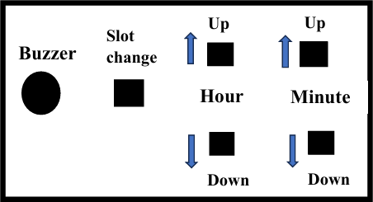
Steps for Operating the Device
Open the top surface of the device,you will find two slots-the right slot and the left slot.
Insert pills into these slots and close the top surface.
Start the device by providing power supply.
If needed, select slots using the slot change button.
Set the alarm hour time for the slots using the Hour Up and Hour Down buttons.
Set the alarm minute time for the slots using the Minute Up and Minute Down buttons.

Slide 10
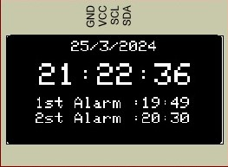
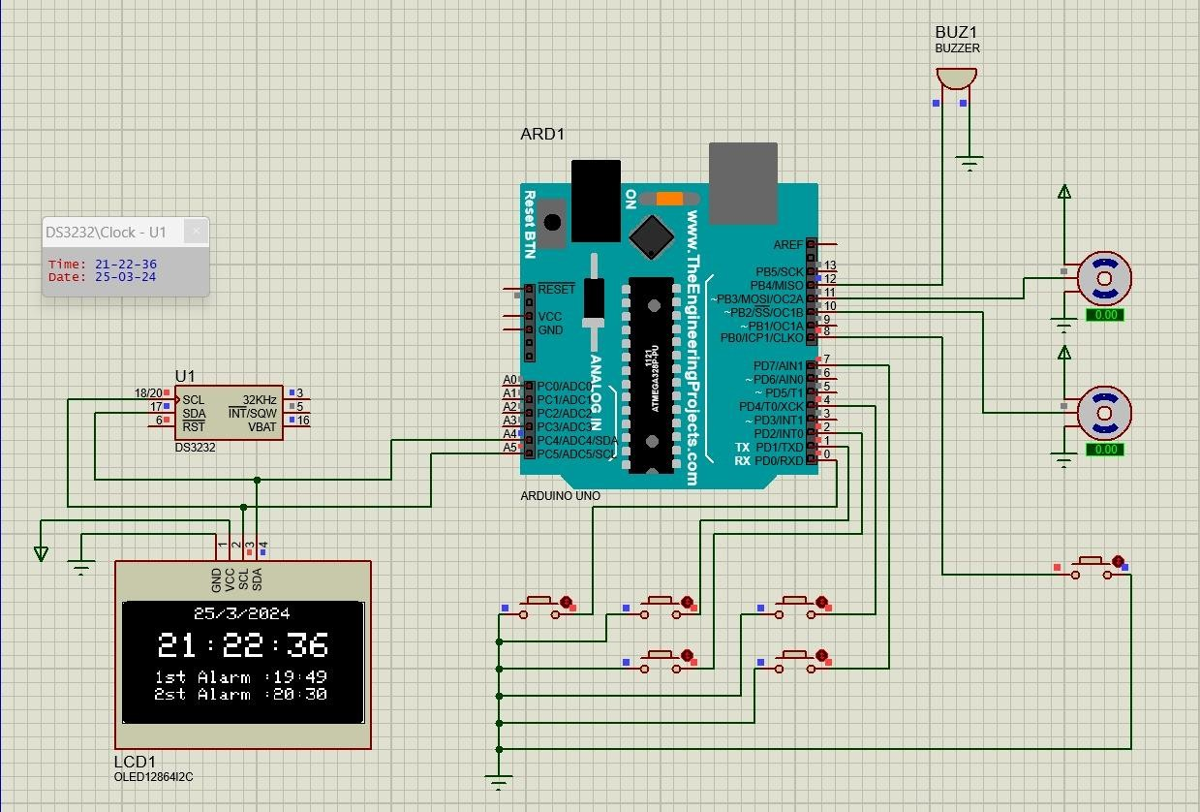
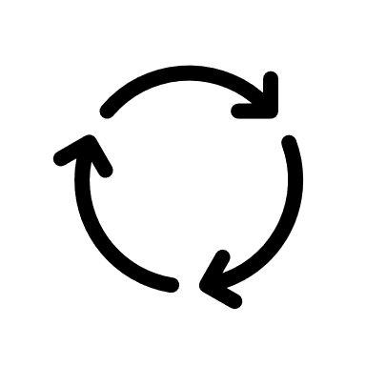
Simulation Result
Servos rotate to move the
flap that dispense medicine
Alarm details displayed on
screen
EEPROM stores the data of
alarms set

Slide 11

Feasibility Analysis
Market Feasibility- There is significant scope and opportunities for this product as it can be modified for serving various purposes:
1. Hospitals:
Creating a centralised system for
monitoring doses of all patients.
2. Family(Multi-user):
A single device can be programmed for
multiple user to use at a time.

Slide 12
Feasibility Analysis
Cost:
The prototype has cost of INR 1800.
Negligible maintenance cost.
Does not require any additional charges like subscription or installation charge.
Market trends and Growth-
There is an increasing demand for different Pill dispensers and medicine assistants that
can serve varying purposes in different settings, hence creating huge market opportunities.

Slide 13
Innovation and Uniqueness of the solution
Displaying the alarm details to provide visual cue to the user.
Multiple slots to enable multiple medicine administration.
Provision to set multiple alarms for different medicines.
Dispenser customizable to match the dosage requirement.
Requires one time feeding of medicines.

Slide 14

Impact or Usefulness of the solution
IMPACT:
- Regular medicine administration.
Reduced load on nurses / caregivers.
- Independence of patients from remembering the time and dosage of medicine.
USEFULLNESS:
People with cognitive problems and old age people.
Can be implemented in hospitals by integrating IoT and centralized monitoring system.

Slide 15
Summary
Develop a cost-effective pill dispenser to reduce errors and caregiver dependence, with customizable features and multiple medicine slots.
Utilizes Arduino Uno, RTC module, OLED display, push buttons, servo motor, and buzzer for alarm. Alarm data is stored in EEPROM.
Feasible with affordable components (INR 1800 upfront cost) and low maintenance, offering a
practical alternative to existing solutions.
Enables error-free medication administration, reduces caregiver workload, and promotes patient independence, particularly beneficial for the elderly and those with cognitive issues.
Useful in both personal and hospital settings, potentially integrating with IoT for centralized monitoring.

Slide 16
References
[1]https://patents.google.com/patent/US11484474B2/en?q=(pill+dispensers )&oq=pill+dispensers&page=1
[2]https://patents.google.com/patent/US9597261B2/en?q=(pill+dispensers)&oq=pill+dispensers&page=2
[3]https://patents.google.com/patent/US7359765B2/en
[4]https://patents.google.com/patent/US6004020A/en
[5]https://www.medacube.com/
[6]https://www.epill.com/medsmartvoice.html
[7] https://github.com/adafruit/RTClib
[8] https://github.com/arduino-libraries/Servo

Slide 17
References
[9] https://github.com/adafruit/Adafruit_SH110x
[10] https://docs.arduino.cc/hardware/uno-rev3/
[11] https://en.wikipedia.org/wiki/Arduino_Uno
[12] https://ecsxtal.com/what-is-a-real-time-clock-rtc/
[13]https://ww1.microchip.com/downloads/en/DeviceDoc/Atmel-7810-Automotive-Microcontrollers-ATmega328P_Datasheet.pdf
[14]https://www.healthline.com/health/pill-dispenser#our-picks

